Slide 1
Where Relationships Begin
Experience – Diversity - Results

Slide 2
Experience the Difference!
The sports tournament industry’s leading annual print guide for 16 years
Bi-weekly e-newsletter published continuously since 2009
Internet’s web authority @ SportsPlanningGuide.com

Slide 3
Diverse Readership
Sports Events Rights Holders representing all aspects of youth, amateur and professional sports.
National Governing Bodies for all Olympic and Paralympic sports.
NCAA, NAIA, NJCAA College leagues, athletic conferences and event planning departments.

Slide 4
What You Can Expect
Expertly researched, written and produced content marketing depicting your destination and tournament-ready facilities.
Superior communication of your brand across print, digital, social and e-mail channels.
Year-round marketing of your destination and top facilities!

Slide 5
Industry’s Leading Planning Guide
Trending feature stories
Insight from industry professionals
Over 100 destinations profiled
Hundreds of tournament-ready venues
Published each October – 10,000 subscriber base
Annual programs from $2,495

Slide 6
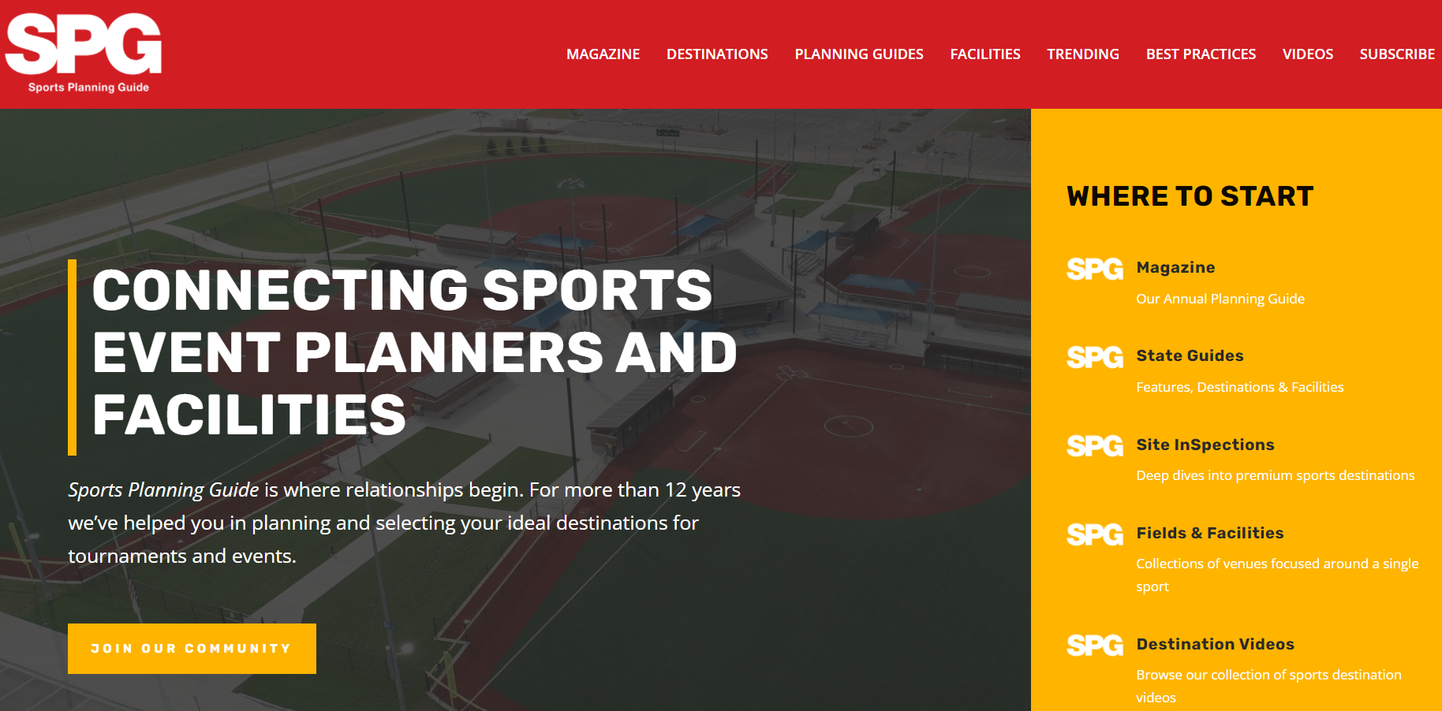
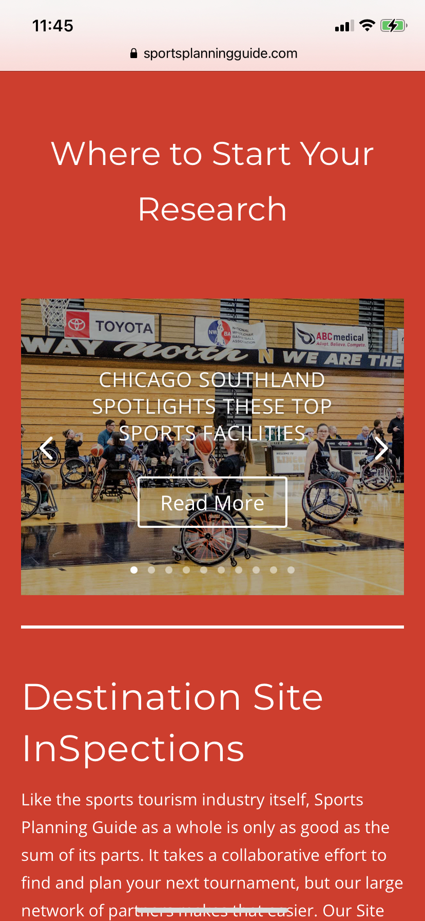
Online Authority @ SportsPlanningGuide.com
BRAND NEW website launched January 2022
Detailed venue reviews and comparisons
Expert-level advice and columns
More than a dozen state sports organization guides
116,000 + website visitors
Corporate sponsorships from $3,995
Featured facilities & destinations $1,995

Slide 7
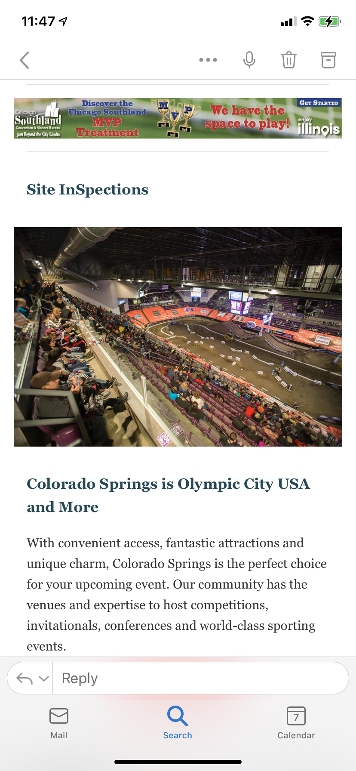
Email Inspiration!
Bi-weekly InSite e-newsletter (5,000 subscribers)
Interviews with tournament planners
Email exclusives
Downloadable resources
3-month programs from $1,795

Slide 8
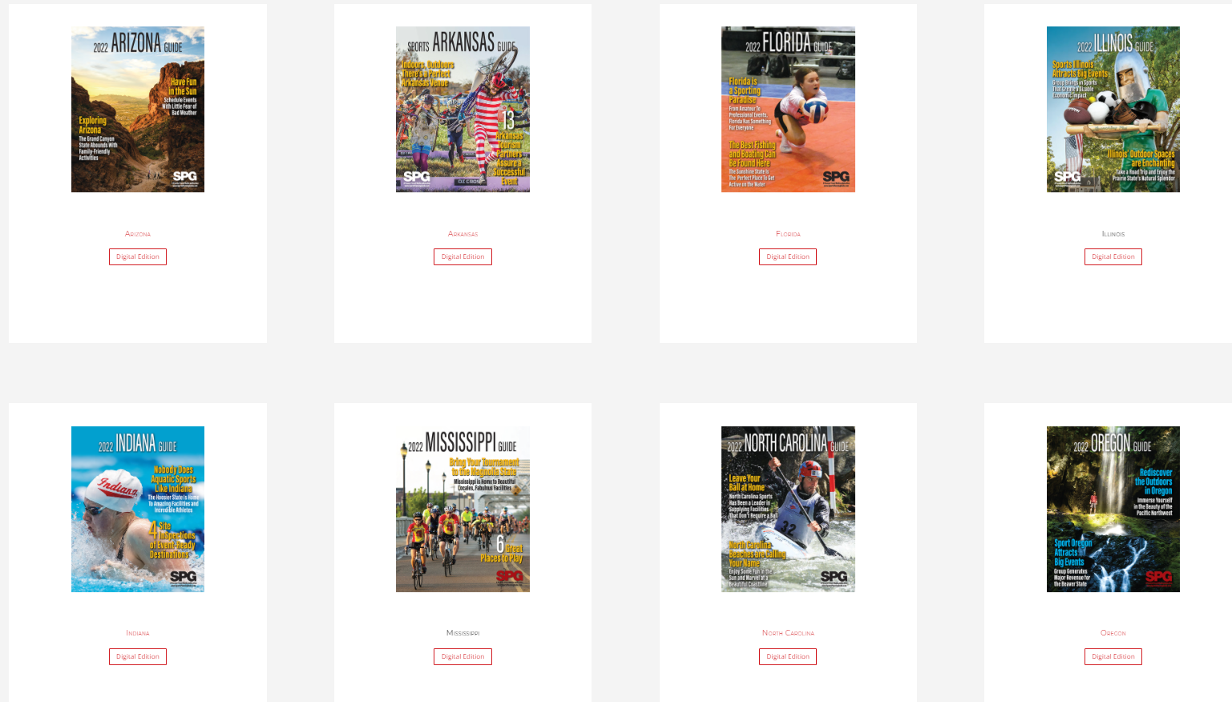
State Guide Partnerships
We partner with over a dozen state organizations on carving out their unique niche in the sports tourism landscape.
Our state guides feature professionally researched and written feature stories, detailed facility maps, state branding, partner content and advertising.
Multiple funding options – state sponsored, buy-down or partner supported.

Slide 9
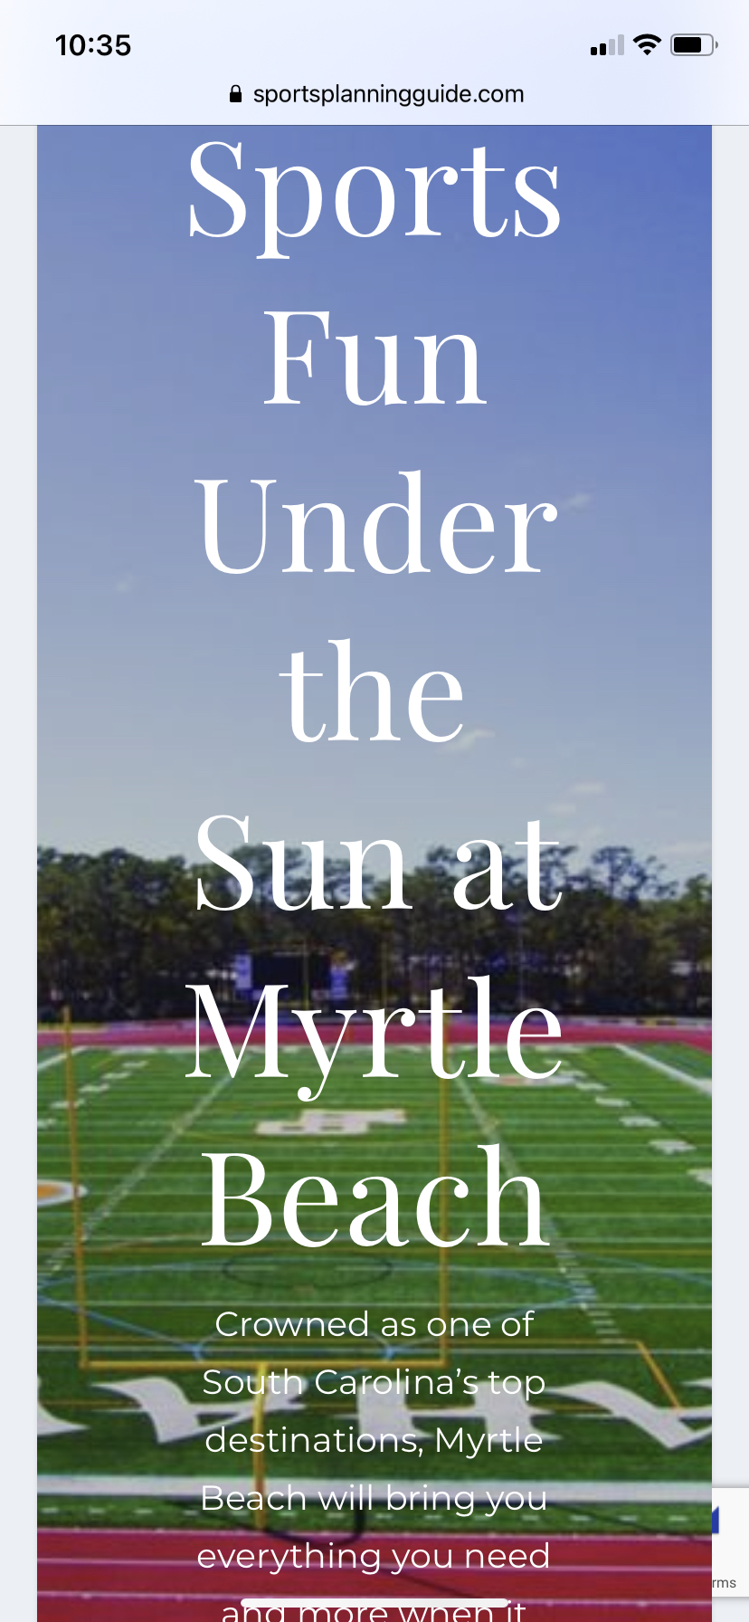
Package A+ Unparalleled Exposure
4 pages in SPG (2 pages of “Site InSpection” branded content, plus a two-page spread ad).
Guaranteed preferred position!
Digital Site InSpection content marketing feature written and optimized for you on SportsPlanningGuide.com.
Featured in one edition of the InSite e-newsletter
Social campaign on LinkedIn and Facebook.
$6,495

Slide 10
Package A Print and Digital Dominance
3 pages in SPG (2 pages of “Site InSpection” branded content, plus a full-page ad).
Digital Site InSpection content marketing feature written and optimized for you on SportsPlanningGuide.com.
Featured in one edition of the InSite e-newsletter
Social campaign on LinkedIn and Facebook.
$4,695

Slide 11
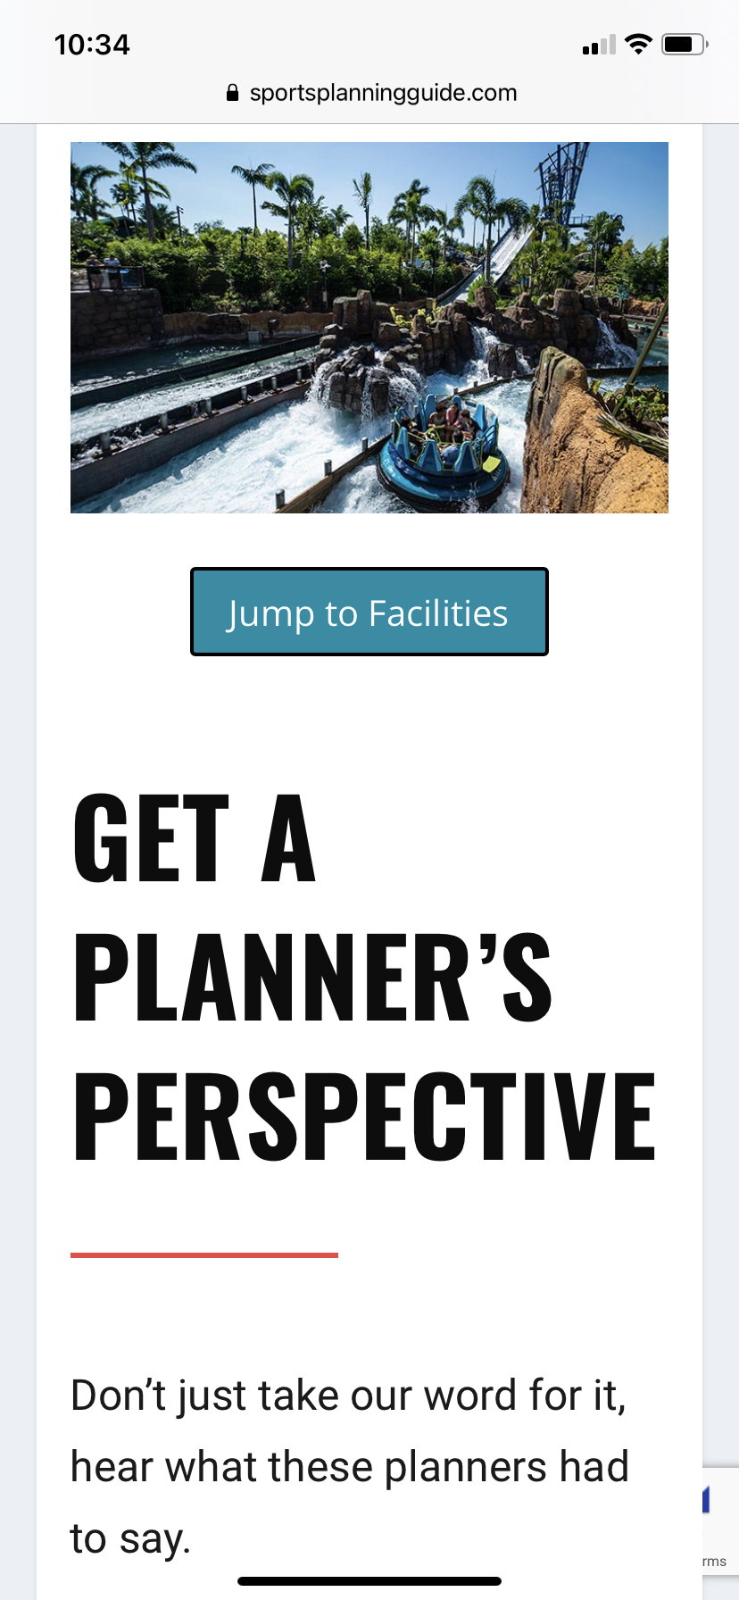
Package B Print and Digital Competitive
2 pages in SPG (1.5 pages of “Site InSpection” branded content, plus a ½-page ad).
Digital Site InSpection content marketing feature written and optimized for you on SportsPlanningGuide.com.
Featured in one edition of the InSite e-newsletter.
Social campaign on LinkedIn and Facebook.
$3,595

Slide 12
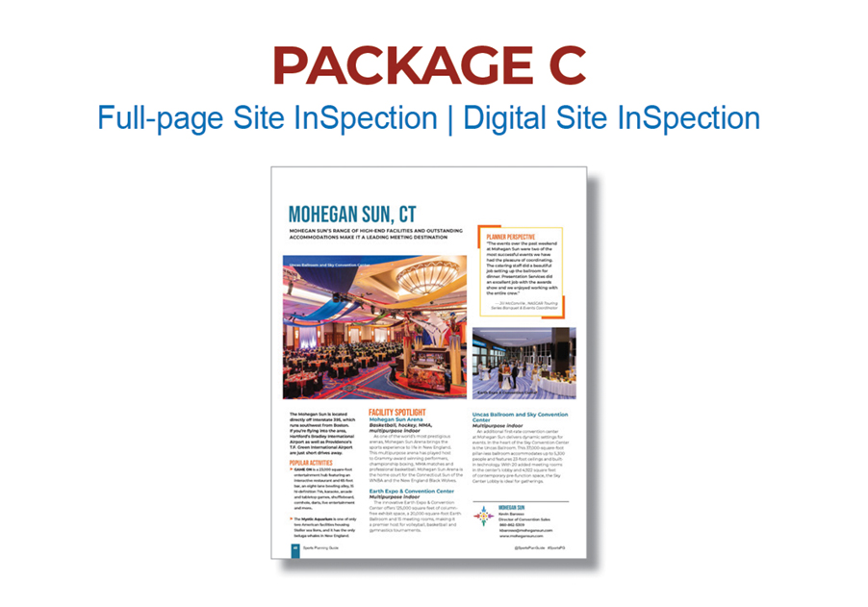
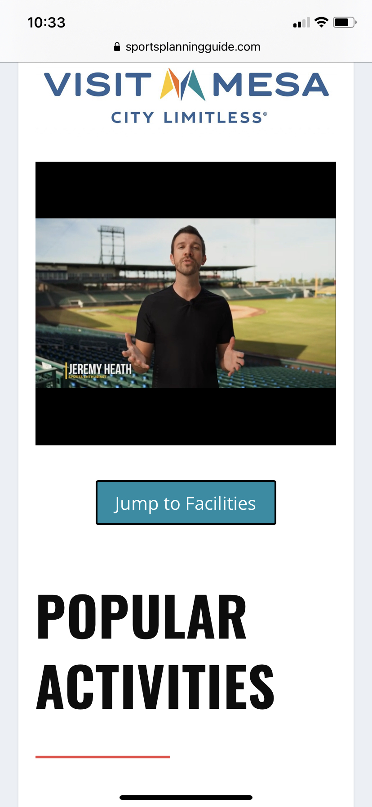
Package C Introductory/Starter Program
1 page in “Site InSpection” branded content in SPG.
Digital Site InSpection content marketing feature written and optimized for you on SportsPlanningGuide.com.
Featured in one edition of the InSite e-newsletter.
Social campaign on LinkedIn and Facebook.
$2,495

Slide 13
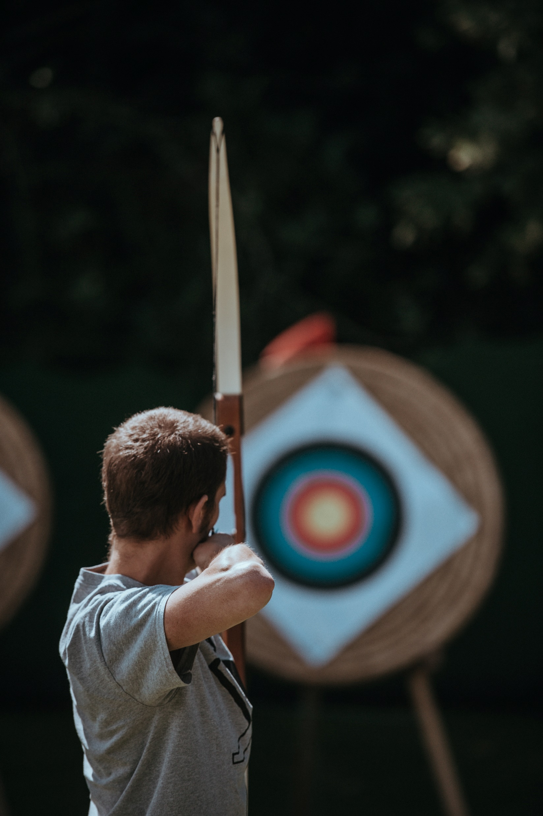
Let’s Get Started!
We’re here to help grow your sports tournament business!
Publisher
Jeff Gayduk
630.794.0696 x 507
Jeff@PtmGroups.com
Associate Publisher
Dave Bodle
630.794.0696 x. 513
Dave@PtmGroups.com
Business Development Manager – South
Cheryl Rash
630.794.0696 x512
Cheryl@PtmGroups.com

